Slide 1
Pet Bowl Water Sensor
Team Pontiac
Nate Gross

Slide 2
Product Concept
The “Pet Bowl Water Sensor” will send e-mail notifications to your device that contain water level statuses such as FULL, LOW, and CRITICAL. Additionally, it is setup to receive an input from the user to define the receiving email address in order to enable customization. In this report we will detail the accuracy and response time as well as the costs and marketability for this item.

Slide 3
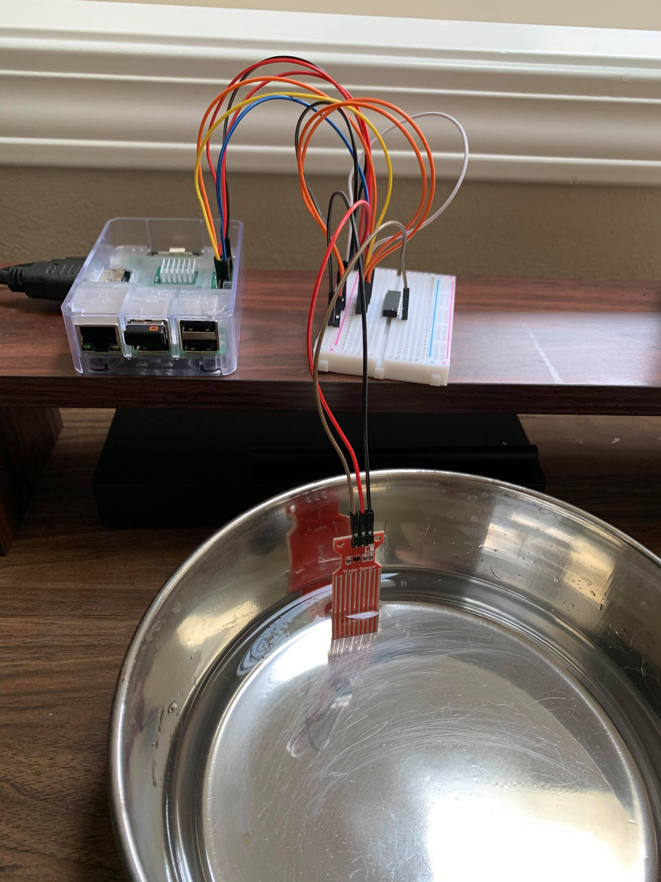
Hardware / Software
Hardware Raspberry Pi 3 Rain water level sensor MDC3008 ADC Breadboard Micro SD Card (8GB) Male to male/ female to male wires
Software Raspbian (OS) Thonny IDE (Python)

Slide 4
Python Libraries
Multiple libraries used in the Python program:
Time – insert delays for notifications and sampling rate
RPi.GPIO – used to communicated with sensor
SSL/SMTPLIB/MIMEx – to send an email notification to the end user with alerts on water levels
CSV – for data collection and repeatability testing

Slide 5
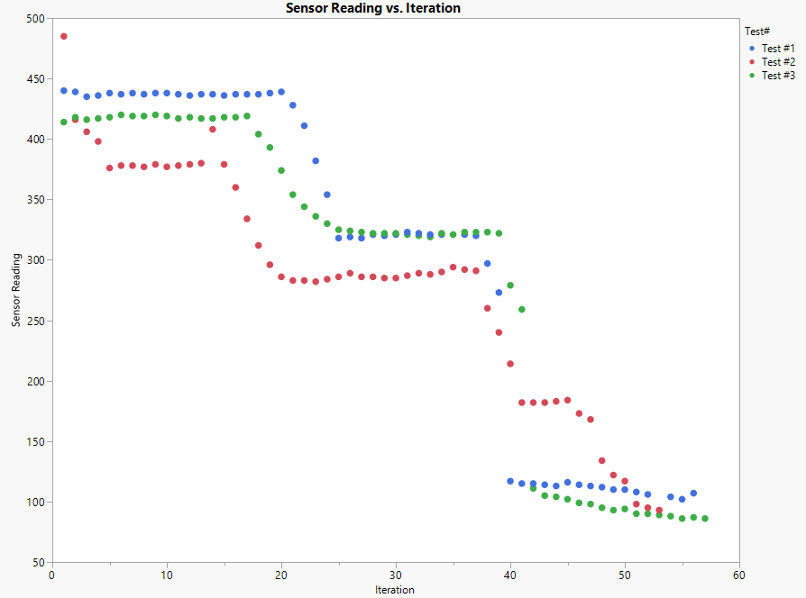
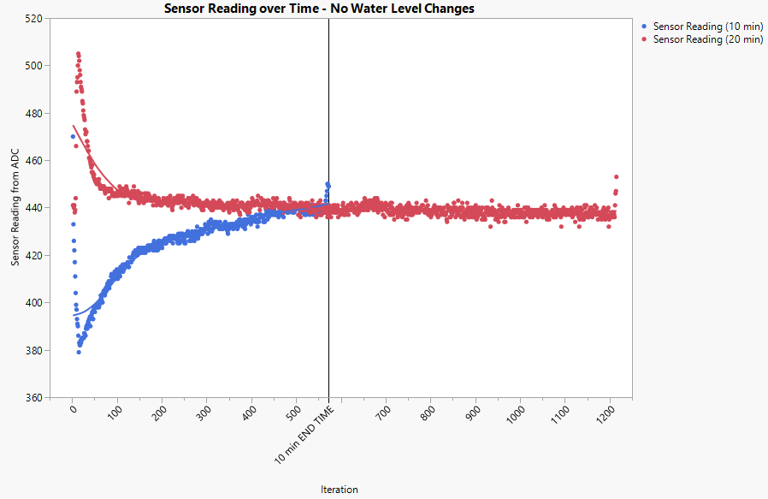

Reliability Testing Results and Conclusion
Repeated trial runs
Resulted in both similar and successful outputs
Each test showed a step function response to new state and e-mail was successfully generated.
Testing over extended period
Stable signal over time periods of 10 minutes and 20 minutes.
Outlier data only observed upon startup.

Slide 6

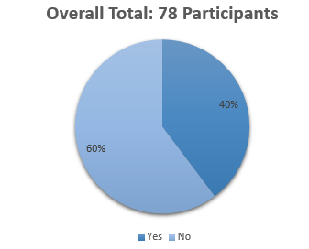
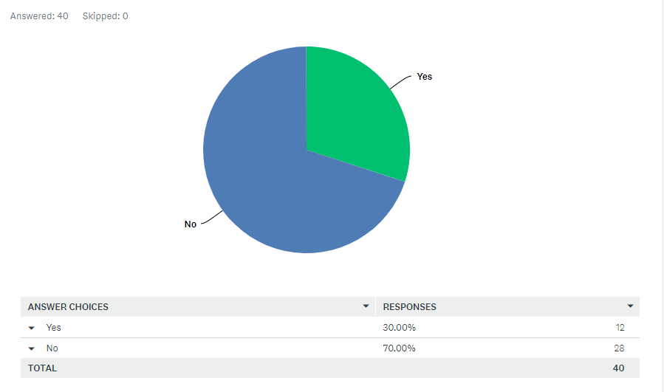
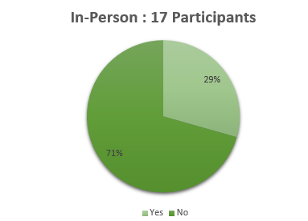
Cost and Marketing Results and Conclusions
Collected survey data from online forums via polls and in-person surveys for market research.
Conclusion showed an overall negative reception to the initial price of $149.99. Based on this feedback, the product was re-designed to include a cost-effective sensor and price point reduced to $64.
# | Desc | Qty | Cost | Supplier
1 | Raspberry Pi 3 | 1 | $35 | Amazon (online)
2 | Rain Water Level Sensor | 10 | $6 | Adafruit Industries (online)
3 | MCP3008 ADC (Analog to Digital Converter) | 1 | $4 | Adafruit Industries (online)
4 | Breadboard | 1 | $5 | Adafruit Industries (online)
5 | Micro SD card (8GB) | 1 | $10 | Adafruit Industries (online)
6 | Male to Male/Female to Male wires (6”) | 2 | $4 | Adafruit Industries (online)
TOTAL COST |  |  | $64
Facebook

